Slide 1
COMP 4332 / RMBI 4310 Big Data Mining (Spring 2020)
Project 2 Social Network Mining
TA: Xin Liu (xliucr@connect.ust.hk)

Slide 2
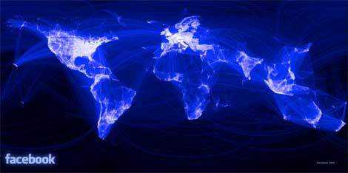
Social Network
https://www.datacenterknowledge.com/archives/2012/02/02/facebooks-1-billion-data-center-network

Slide 3
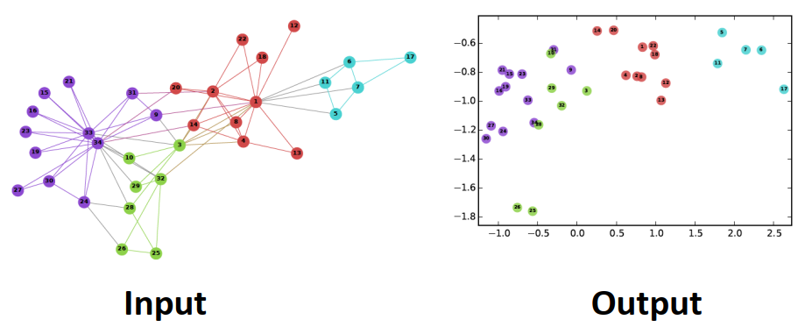
Network Representations
Perozzi, Bryan, Rami Al-Rfou, and Steven Skiena. "Deepwalk: Online learning of social representations." In KDD, pp. 701-710. 2014.

Slide 4
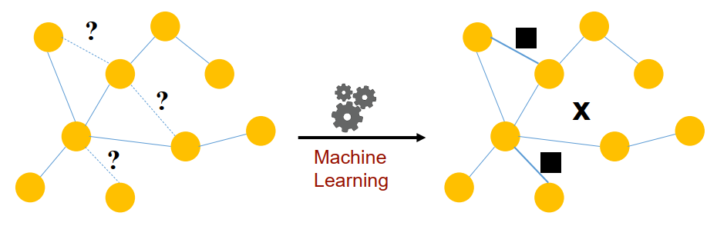
Link Prediction
Predict the relation between nodes with their similarity and calculate the AUC-ROC score.

Slide 5
Pipeline
Data loader
Random walk generator (first-order, second-order, …)
Embedding algorithm (DeepWalk, node2vec, …)
Scorer

Slide 6
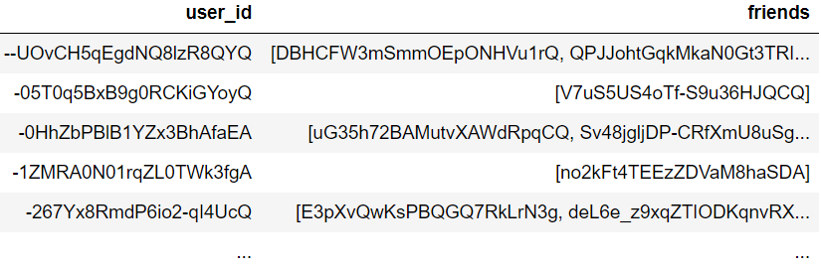
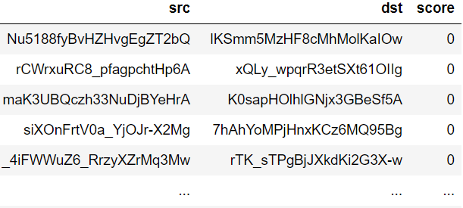
Dataset
training data: 8347 nodes, 100000 edges
validation data: 5388 nodes, 19268 edges
test data: 8505 nodes, 40000 edges (19267 positive edges)
score: [0, 1]
given features: user_id, friends

Slide 7
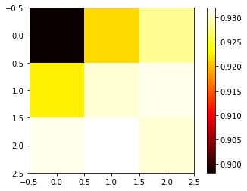
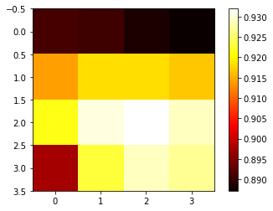
Analysis
Heatmap (https://stackoverflow.com/questions/33282368/plotting-a-2d-heatmap-with-matplotlib)

Slide 8
Evaluation
AUC-ROC score on test data

Slide 9
Submission
Predictions on test data (please make sure you can successfully evaluate your validation predictions on the validation data with the help of evaluate.py)
Report (1~2 pages)
Code (Frameworks and even programming languages are not restricted.)
DDL: May 3, 2020
Submission: Each team leader is required to submit the groupNo.zip file that contains pre.csv, the report, and your team’s code on canvas.
we will check your report with your code and the accuracy.

Slide 10
Grading Rule
Grade | Model (80%) | Report (20%) | Baseline
60% |  | submission
80% | an easy baseline that most students can outperform | detailed explanation | 40000 edges (20732 negative): 92.50%
90% | a competitive baseline that about half students can surpass | detailed explanation and analysis | 40000 edges (20732 negative): 93.00%
100% | a very competitive baseline | excellent visualization and analysis | 40000 edges (20732 negative): 93.30%

Slide 11
Thank You

